Slide 1
Online Payment Fraud Detection
—— CSYE7105 Final Project
Team11 – Zihan Wan ＆ Feifan Tai

Slide 2
Introduction
01
02
Background
With the development and popularity of online and mobile payments, people still face a considerable risk of payment fraud while enjoying this convenience.
Motivation
In the face of the increasing volume of payment transaction data and the rapidly changing market, machine learning algorithm models need to be constantly iterated and updated, and parallel computing methods can undoubtedly save a lot of time and labor costs.

Slide 3
Data Description
This dataset (493.53 MB) contains historical information about fraudulent transactions, its basic information is as follows：

Slide 4
Methodology
Write a function to create metadata for the initial data.
Executing the function serially.
Execute the function in parallel using Multiprocessing Pool and Multiprocessing Process, respectively.
Data processing and feature engineering using NumPy Array and Pandas.
Data processing and feature engineering using Dask Array and Dask DataFrame.
Handling imbalance data by resampling technique using Pandas and Dask.
Training the model with XGBoost.
Adjusting the model parameters by Grid Search with Multiple-GPU and Multiple-CPU.
Using K-fold cross-validation to evaluate the model with Multiple-GPU and Multiple-CPU.

Slide 5
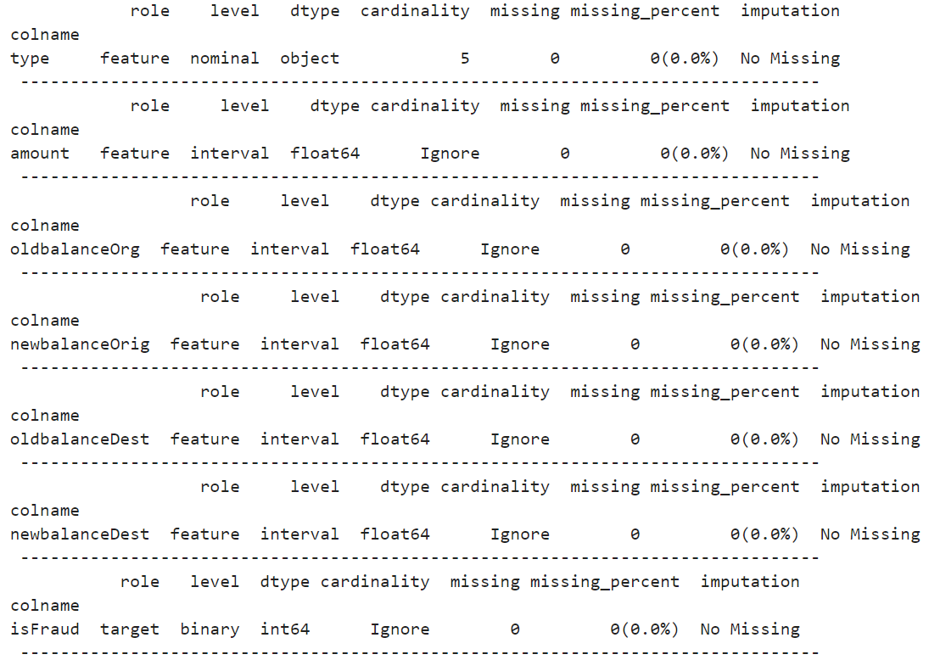
Results and Analysis
01
Metadata
We wrote a function to create metadata, taking the dataset itself and each feature as parameters, returning the name, variable type, data type, number of unique values, number of missing values, percentage of missing values and imputation method for each feature.

Slide 6
Results and Analysis
01
We first tried to use the Pool method, but it did not work as well as we expected, regardless of the number of CPUs.
We analyzed that the causes might be that:
This metadata creation function does not require a lot of CPU resources to parallelize.
The slow startup time of additional processes and communication overhead.
Metadata
Then, we tried using Process method and manually splitting the workload list. Good results were obtained when we split work into n processes, and each process is responsible for 1/n columns.

Slide 7
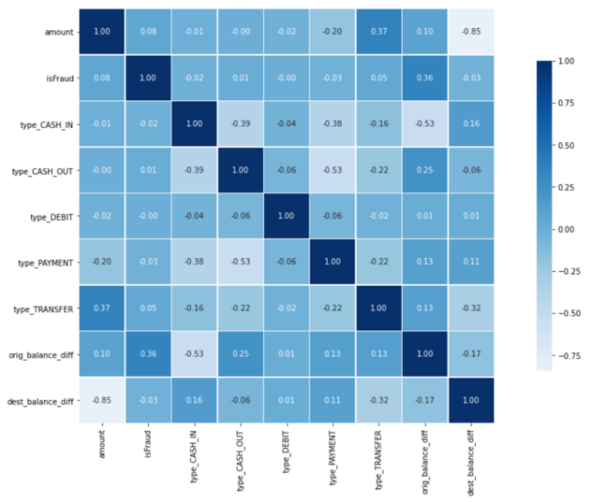
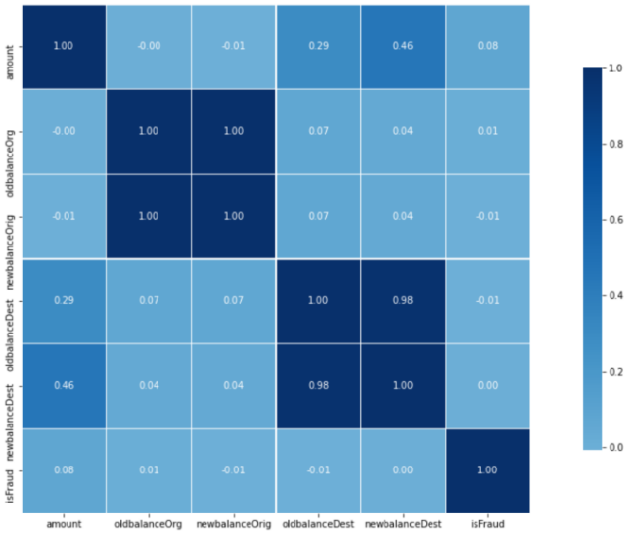
Results and Analysis
02
Feature Engineering
Before
After
For the nominal variable 'type', we encoded it using OneHotEncoder. Then, we calculated the balance difference before and after the transaction and replaced the original features as new features.

Slide 8
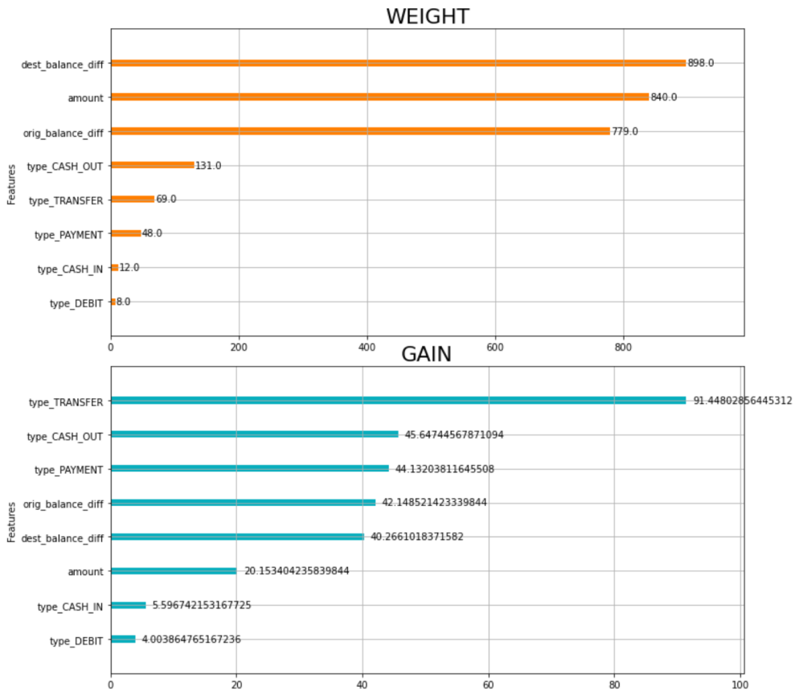
Results and Analysis
02
Feature Engineering
For feature selection, we plotted the feature importance graph based on weight and gain, and selected five features based on comprehensive consideration.

Slide 9
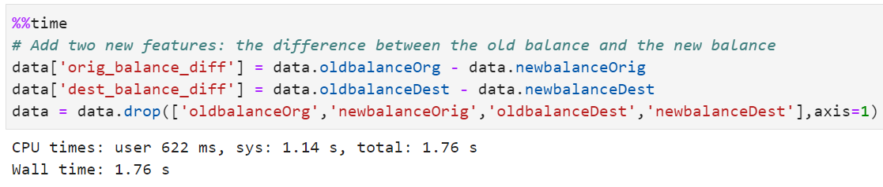
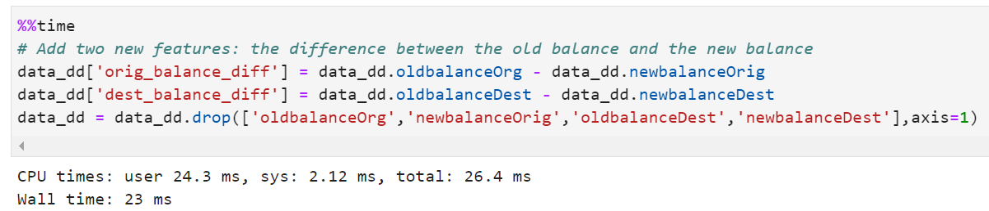
Results and Analysis
02
Feature Engineering
When we switch from NumPy Array to Dask Array, the feature construction(simple calculations) is more than 75 times faster.

Slide 10
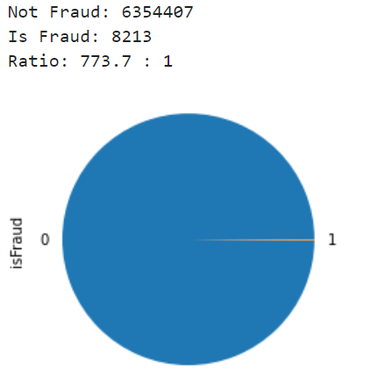
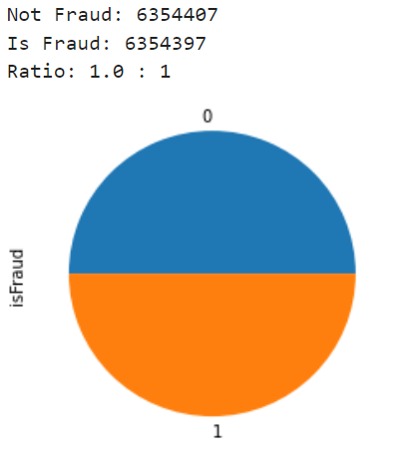
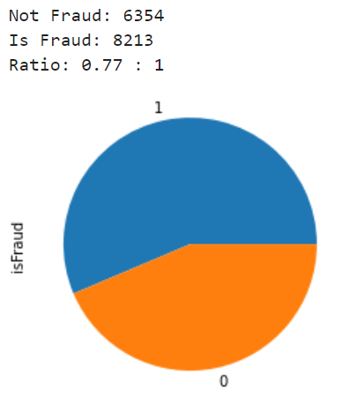
Results and Analysis
03
Resampling
Before
After Oversampling
After Undersampling
Given our observation that our data are extremely unbalanced, we employ resampling techniques (both oversampling and undersampling) to process our data.

Slide 11
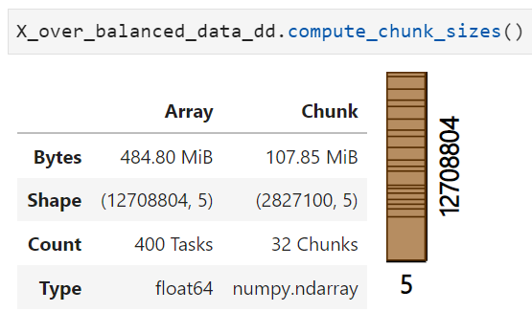
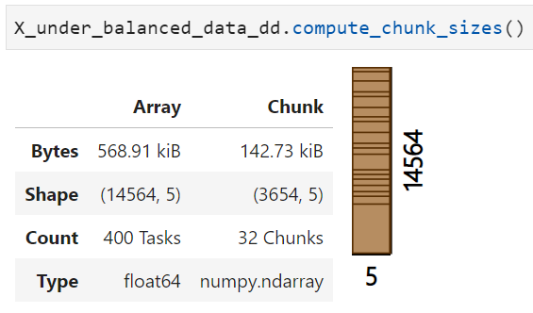
Results and Analysis
03
After Oversampling
After Undersampling
Resampling
So far, we get the balanced data. For the Dask part, we adjust chunksize to an appropriate size.
Since the size of data after using undersampling is too small and its chunksize is also very small, we decided to use only the balanced data obtained after oversampling as the final data.

Slide 12
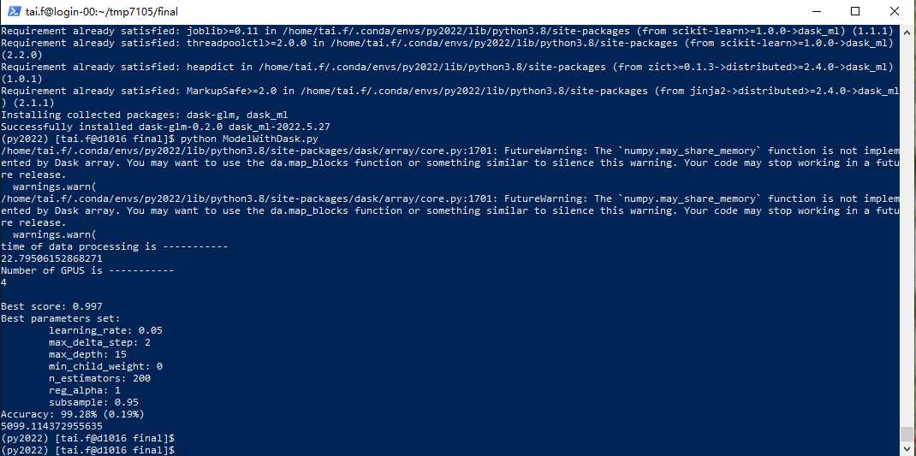
Results and Analysis
04
×14
Model Training
In general, we build model with XGBoost, use Grid Search to adjust the parameters and evaluate the model by K-fold cross-validation.
We performed a total of 14 experiments on Cluster using Pandas and Dask, multiprocessing, Multiple-GPU and Multiple-CPU.

Slide 13
Results and Analysis
04
Model Training

Slide 14
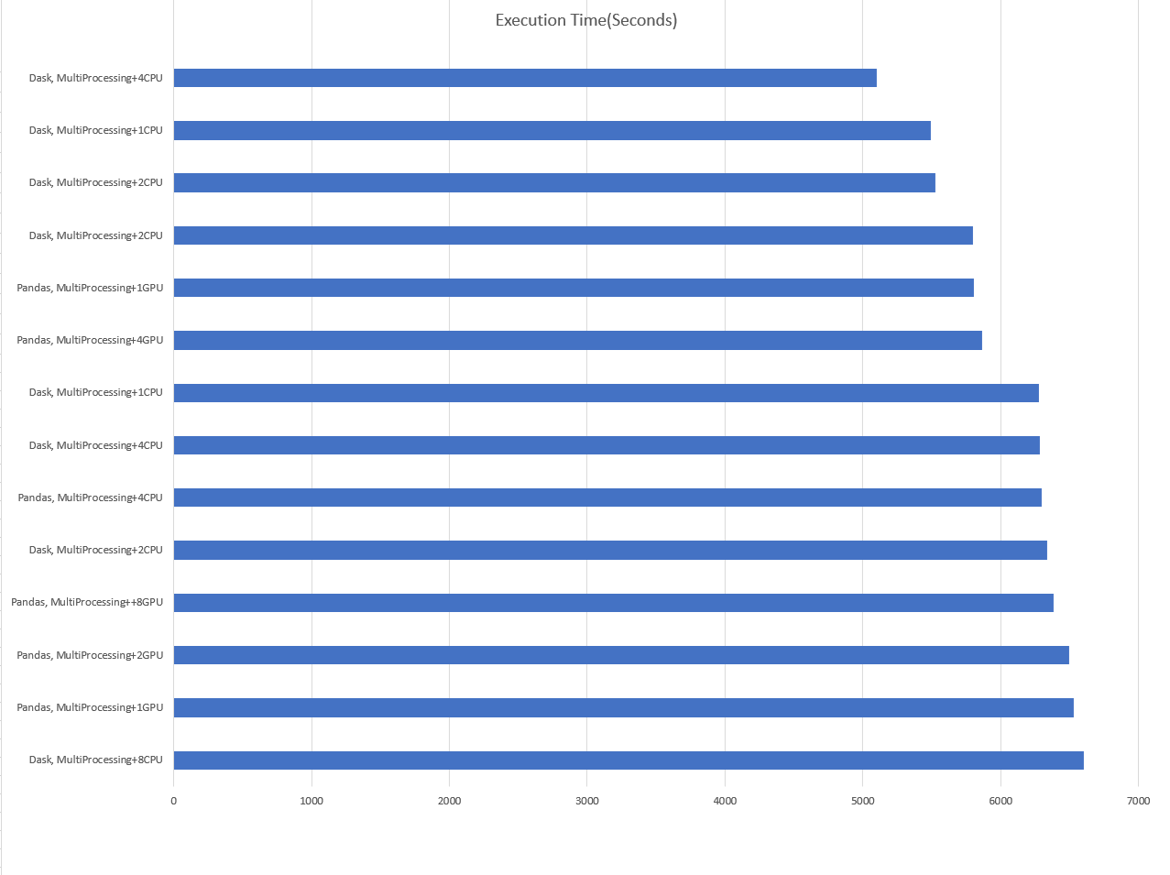
Results and Analysis
04
Model Training
As we can see, the shortest running time is computed in parallel with Dask and multiprocessing on 4 GPUs. The longest running time was computed in parallel with Dask and multiprocessing on 8 CPUs.
So, our optimal results only considering the running speed is to use Dask and multiprocessing to run on 4 GPU.

Slide 15
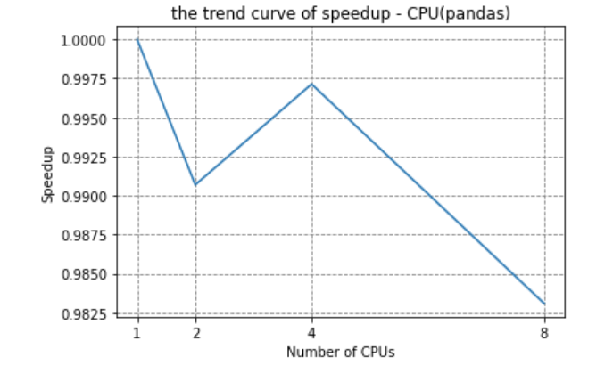
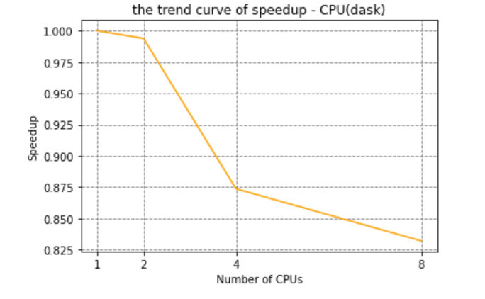
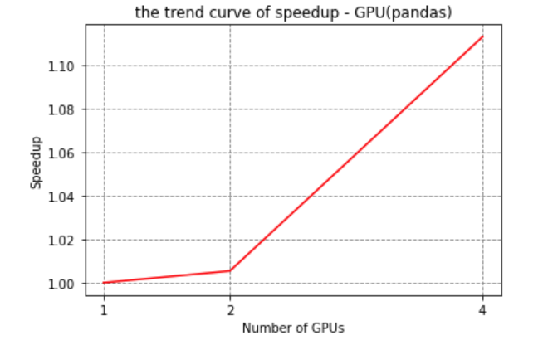
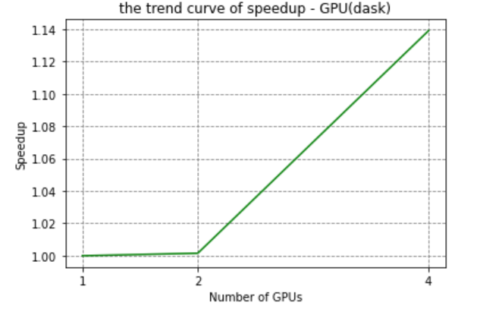
Results and Analysis
Speedup
04
Model Training
Only in the case of using Dask or pandas and multiprocessing method on multiple-gpu, the speedup has an obvious upward trend. All other parallel acceleration effects are not obvious or even decline, especially when the number of CPUs is more than 4.
But in general, the GPU speedup is much better than the CPU, and the overall speedup of Dask is also much better than pandas.

Slide 16
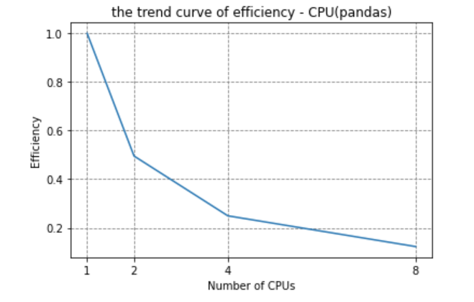
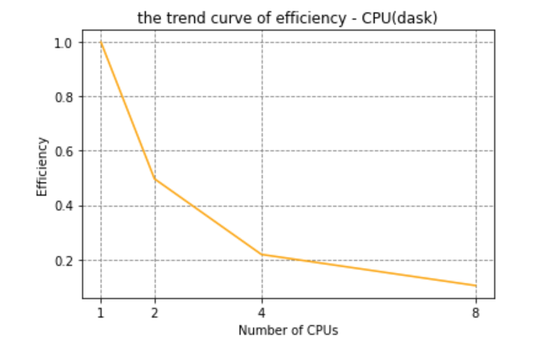
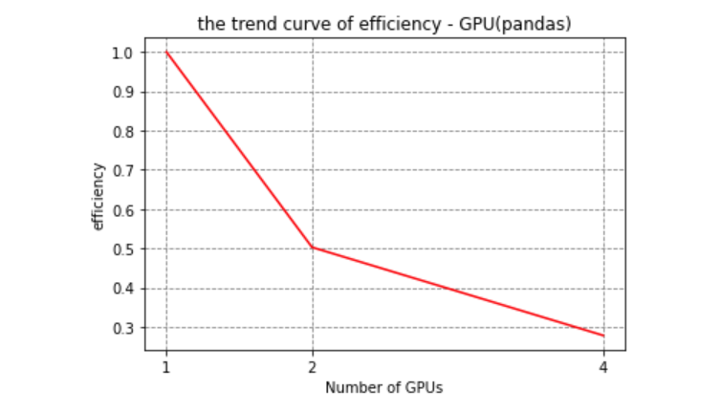
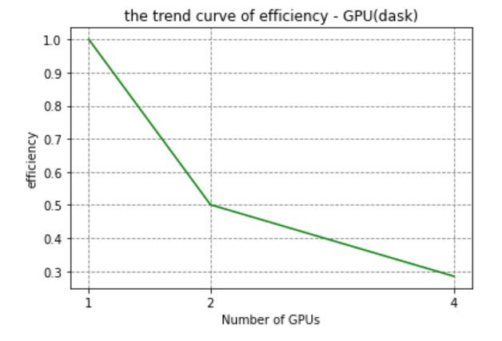
Results and Analysis
Efficiency
04
Model Training
The efficiency of all experiments shows a decreasing trend with the increase of the number of parallel cores, indicating that our parallel method may not be able to make good use of CPU and GPU resources.

Slide 17
Results and Analysis
Analysis of poor performance of Speedup and Efficiency
It's not always guaranteed that we can use the all the recources when run the program on the cluster.
Some parts of model training or parameter adjusting, or cross-validation do not support Dask or multiprocessing for parallel processing.
For the data processing itself, the CPU of a single process can handle it well and does not need additional parallel operations. Parallel operations themselves will bring more resource consumption and computing time
Some data processing inevitably uses a mix of pandas and Dask, because the latest Dask does not fully support some pandas operations. Although the local impact of this time is very small, it may affect the overall effect of Dask lazy calculation.
The compute () method is repeatedly called, which may have a performance poor effect.
Do not adjust the chunk size to an optimal value.
04
Model Training

Slide 18

Conclusions
When using multiprocessing to parallelize a function, the cost of overhead needs to be considered, otherwise it may not be as effective as serial execution.
Proper use of Dask Array can significantly improve the computation time of NumPy Array.
Optimal results only considering the running speed is to use Dask and multiprocessing to run on 4 GPU because the whole efficiency is low.
For our model parallelism is better on multiple-gpu than on multiple-cpu.
The speedup of Dask is good on both multiple-gpu and multiple-cpu but the speedup of multiple-gpu is more significant.

Slide 19
References
Fadyesam. “Online Fraud EDA and Prediction with Accuracy 99%.” Kaggle, Kaggle, 30 Oct. 2022, https://www.kaggle.com/code/fadyesam/online-fraud-eda-and-prediction-with-accuracy-99.
guest_blog. “Imbalanced Classification: Handling Imbalanced Data Using Python.” Analytics Vidhya, 30 Nov. 2022, https://www.analyticsvidhya.com/blog/2020/07/10-techniques-to-deal-with-class-imbalance-in-machine-learning/.
Bahgat, Karim, et al. “Multiprocessing.pool() Slower than Just Using Ordinary Functions.” Stack Overflow, 1 Feb. 1961, https://stackoverflow.com/questions/20727375/multiprocessing-pool-slower-than-just-using-ordinary-functions.
Radečić, Dario. “Dask Arrays - How to Parallelize Numpy with Ease.” Medium, Towards Data Science, 23 Mar. 2022, https://towardsdatascience.com/dask-arrays-how-to-parallelize-numpy-with-ease-b33d7e9dcb59#:~:text=That's%20where%20Dask%20arrays%20provide,deal%2Dbreaker%20for%20some%20cases.
N'Wuitcha, Badji. “How Is Multiprocessing Different from Parallel Computing in Python?” Medium, Better Programming, 22 Oct. 2022, https://betterprogramming.pub/how-is-multiprocessing-different-from-parallel-computing-in-python-4b375c29b183.
Dhariwal, Kunal. “Pandas with Dask, for an Ultra-Fast Notebook.” Medium, Towards Data Science, 31 Oct. 2021, https://towardsdatascience.com/pandas-with-dask-for-an-ultra-fast-notebook-e2621c3769f.
Sravanti TatirajuI have been in the IT industry from 9 years. I worked as a curriculum validation engineer at Oracle for the past 5 years validating various courses on products developed by them. Before Oracle. “Optimize Running Large Number of Tasks Using Dask.” Qxf2 BLOG, 23 Mar. 2021, https://qxf2.com/blog/optimize-running-large-number-of-tasks-using-dask/.
Cavanaugh, Gus. “Quick and Dirty DataFrame Processing with CPU & GPU Clusters in the Cloud.” Medium, Medium, 29 Oct. 2021, https://medium.com/@GusCavanaugh/quick-and-dirty-dataframe-processing-with-cpu-gpu-clusters-in-the-cloud-c50d0ecfba92.

Slide 20
Thank you!
Team11 – Zihan Wan ＆ Feifan Tai

